Slide 1

ELLIPSE ENDORSE ENTERTAIN
MARKETING PLAN

Slide 2
SECTORS
PRINT MEDIA
ELECTRONIC MEDIA
EVENT MANAGEMENT
DIGITAL MEIDA
MARKETING RESEARCH

Slide 3

PRINT MEDIA
All over TN hoardings.
All over TN Malls hoardings(Out side & inside)
Approved road side hoardings
Bus stand hoardings
Back light hoardings ( All over TN)
Toll plaza hoardings
Car branding( Friends Track, Fast Track…Etc)
Air port Hoardings
Railway Station Hoardings
Bus panel
Wall posters.
News paper ads & Weekly Books ( Vikadan, Kalki…Etc )

Slide 4
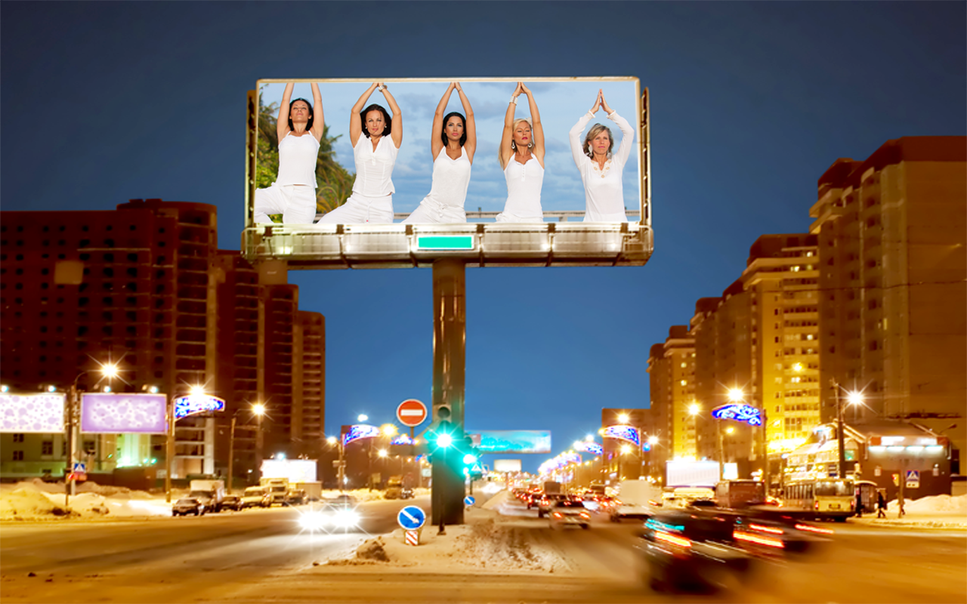

HOARDING

Slide 5
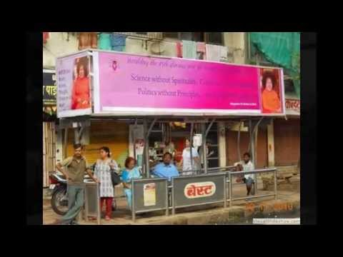
BUS SHELTER

Slide 6
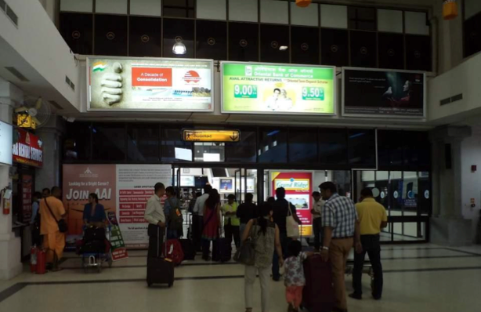
BACK LIGHTS

Slide 7
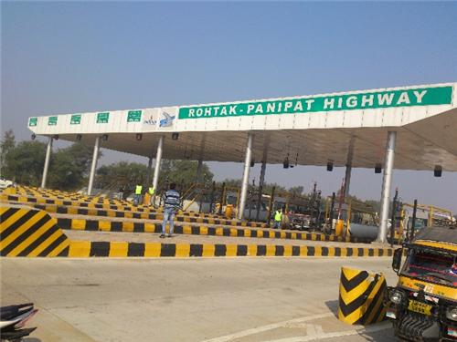
TOLL PLAZA HOARDINS

Slide 8
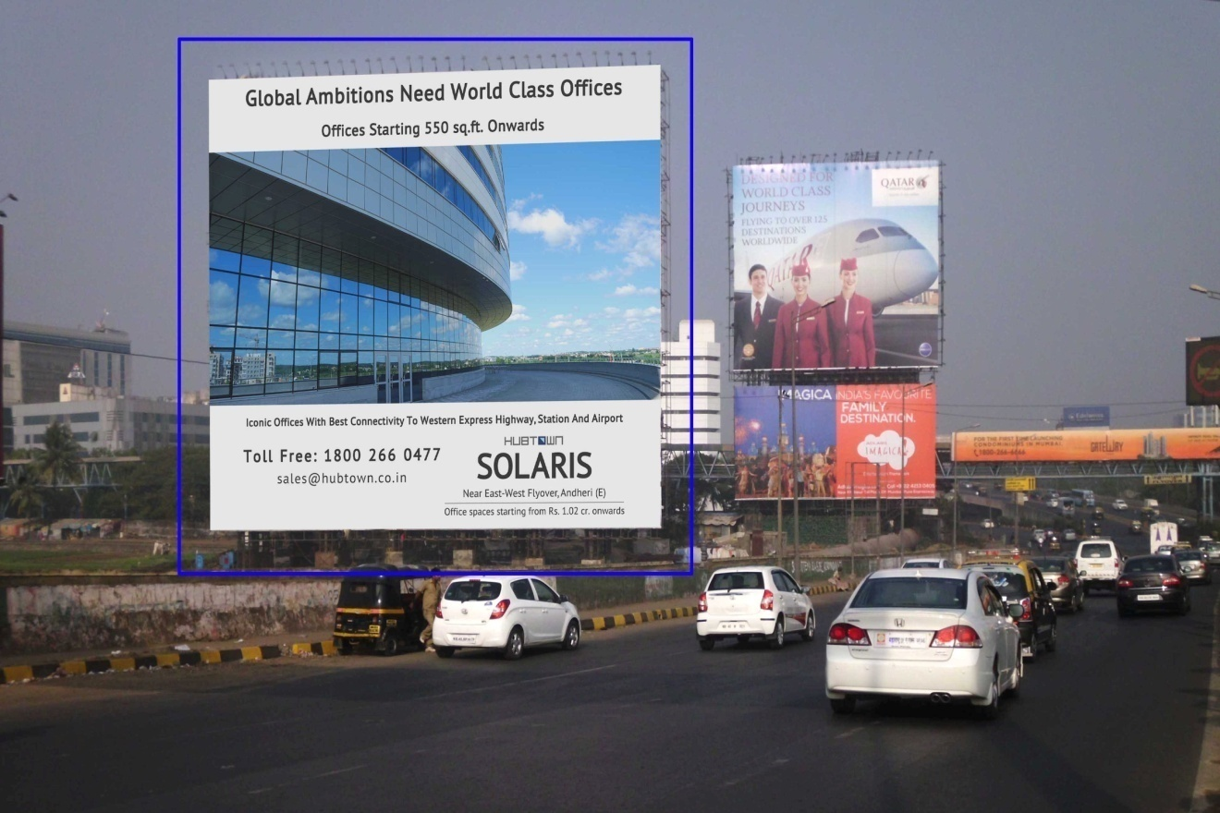
BIGGEST HOARDING

Slide 9
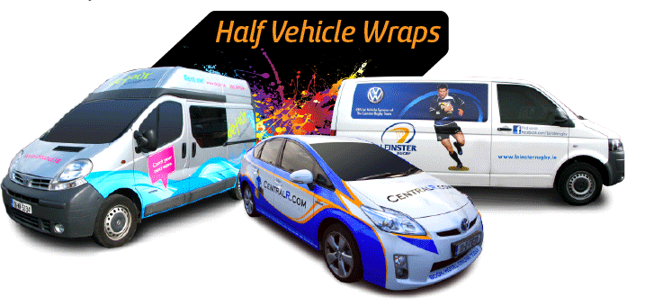
CAR BRANDING

Slide 10
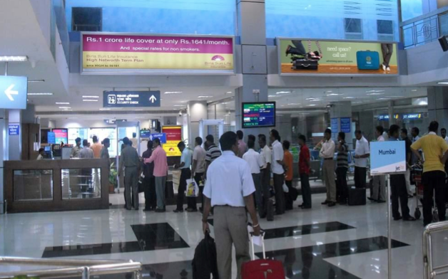
AIR PORT HOARDING

Slide 11
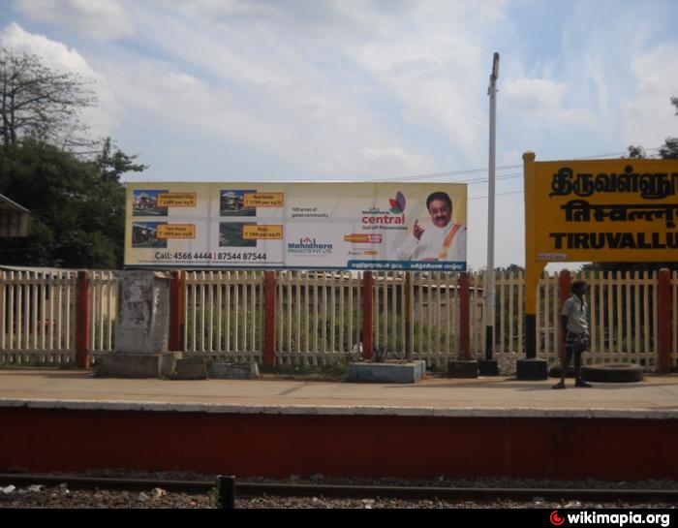
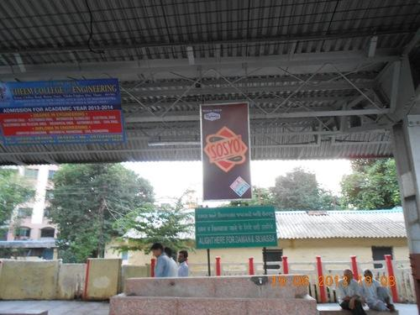
RAILWAY STATION HOARDING

Slide 12
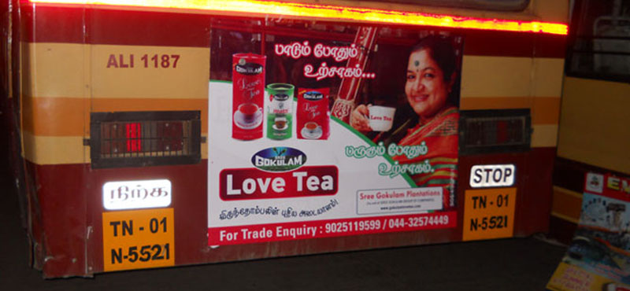
BUS PANEL

Slide 13
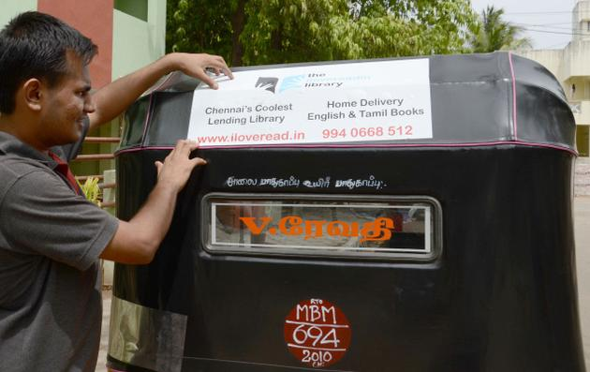
AUTO ADVERTISEMENT

Slide 14
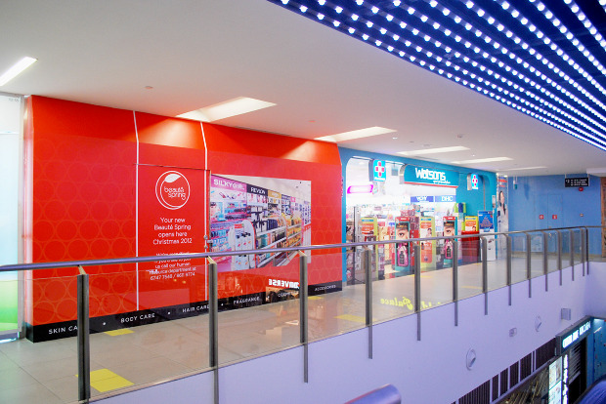
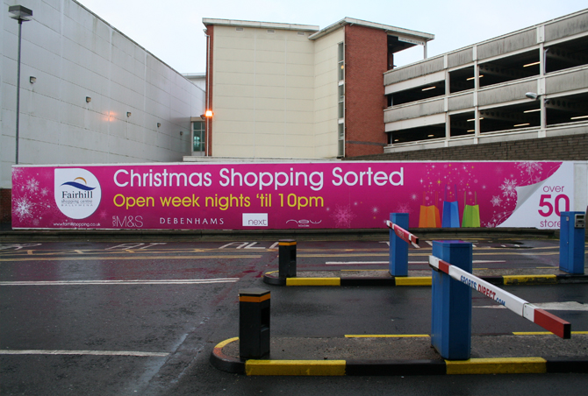

MALL HOARDING IN & OUT

Slide 15
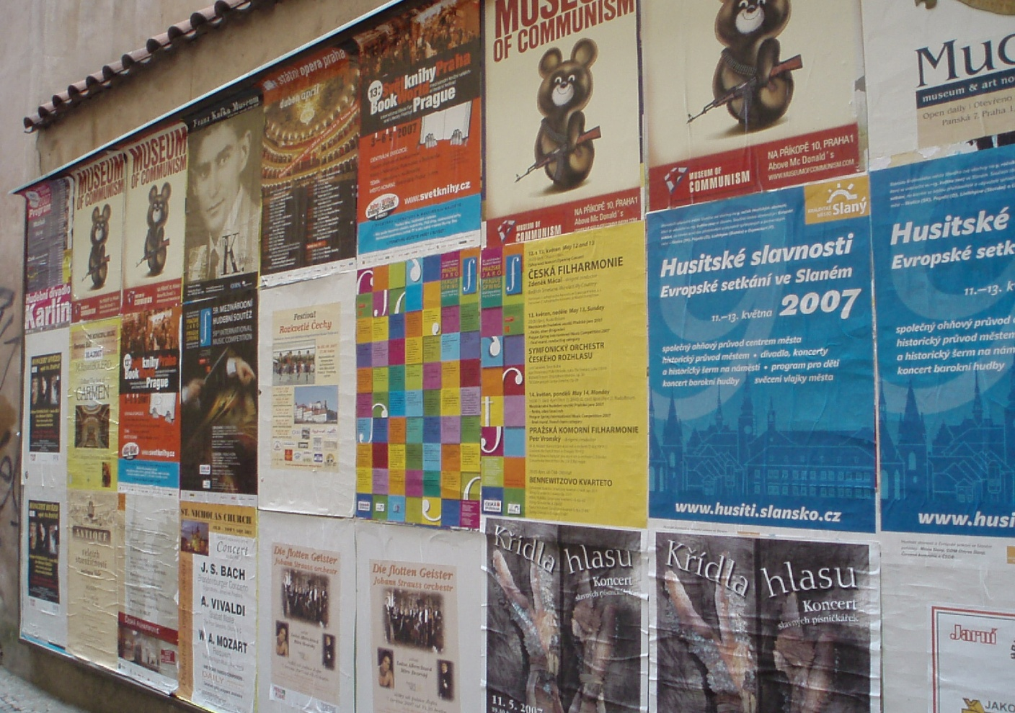

WALL POSTER

Slide 16
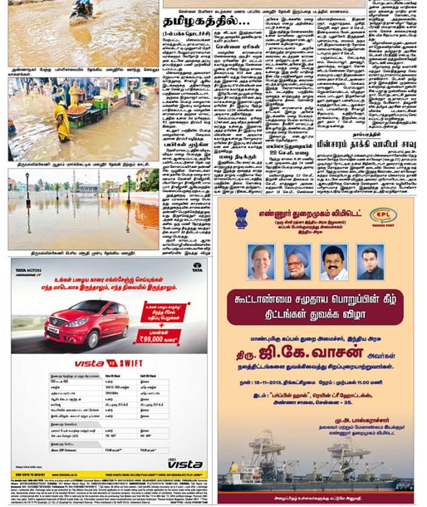
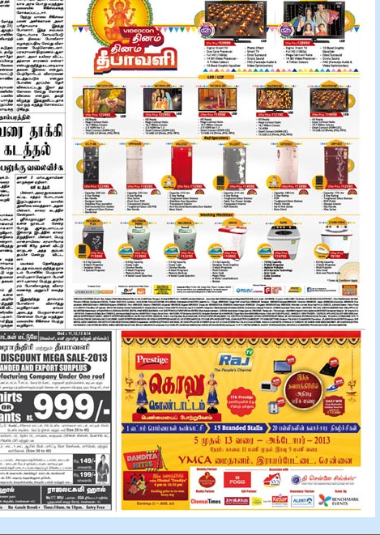
NEWS PAPER AD

Slide 17


PAMPHLET DESING & PRINT

Slide 18
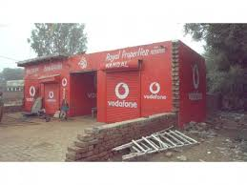
WALL PAINTING

Slide 19
ELECTRONIC MEDIA
Strategic Branding
Commercial add film making for branded product.
Documentary film for corporate companies
Production work for corporate sector & movie sector
Product promotions.
All kind of promotional activity

Slide 20
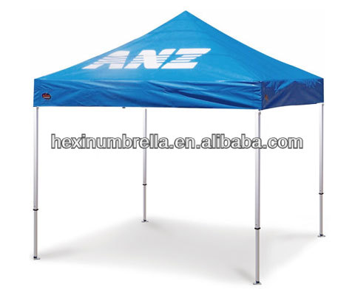
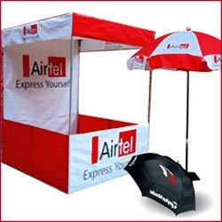
PRODUCT PRMOTION STALL

Slide 21
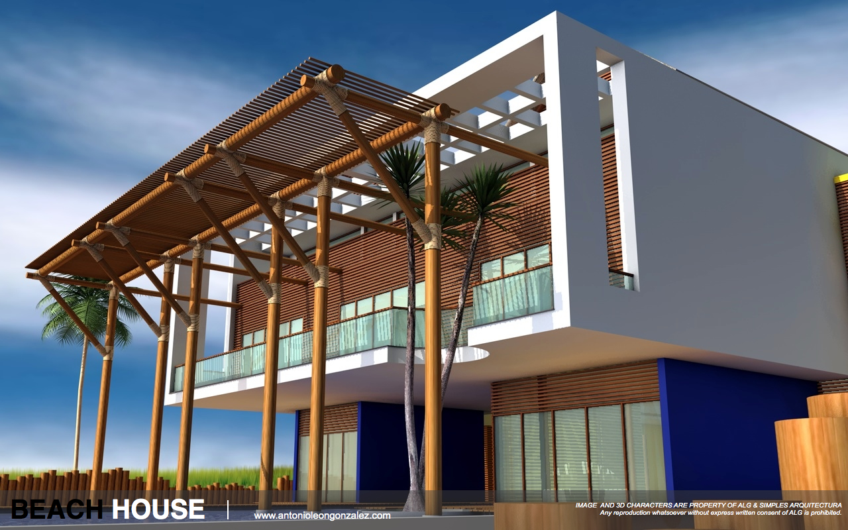
CG WORKS

Slide 22
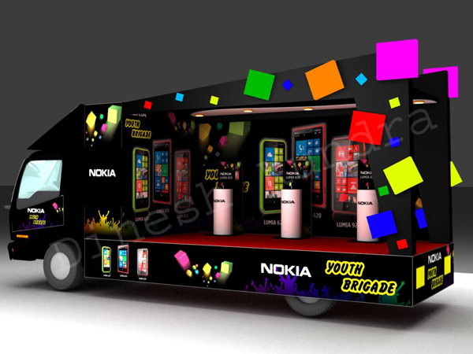
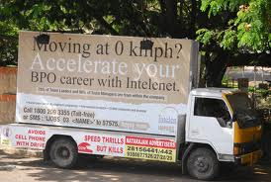
CANTER VEHICLE

Slide 23
EVENT MANAGEMENT
All kind of events conducting malls, private auditor yam Companies & Resorts
Celebrity event for branded products.
Product promotion event
Corporate company event

Slide 24
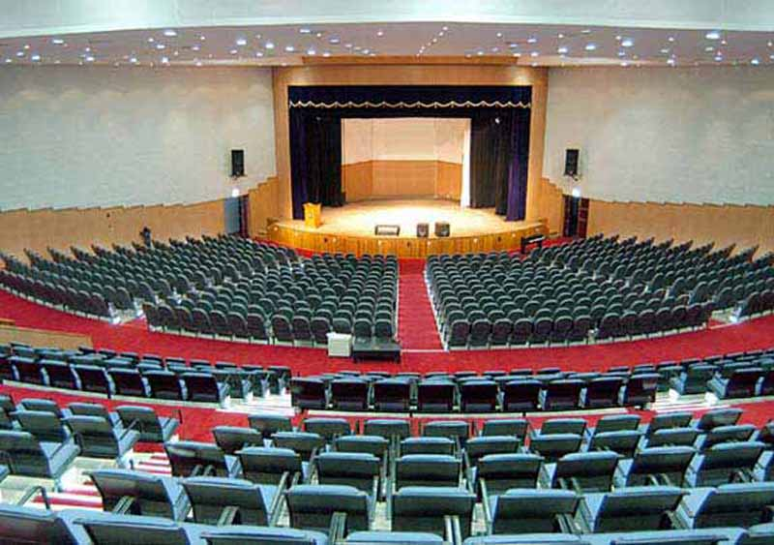
BRAND EVENT AUDITORIUM

Slide 25
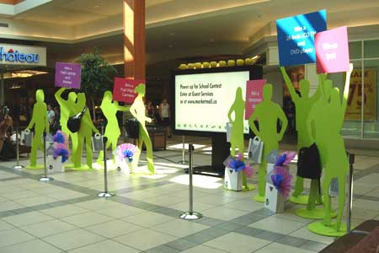
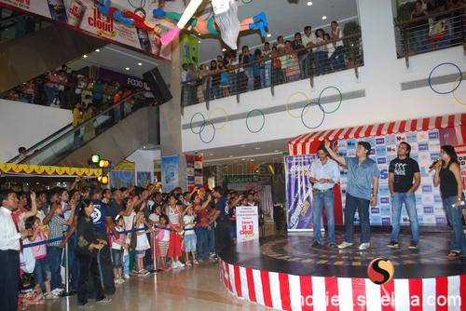
PRODUCT PROMOTION EVENT

Slide 26
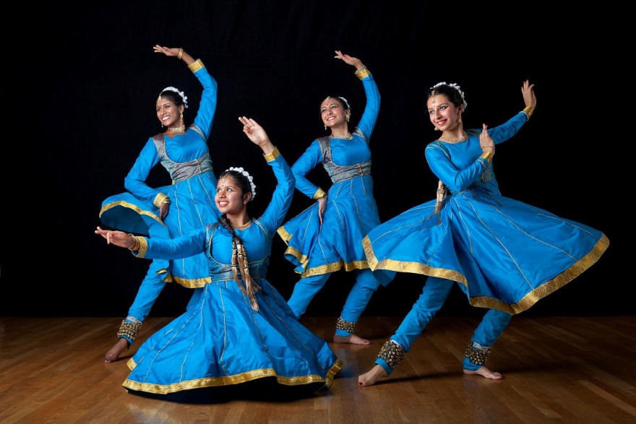
ENTERTAINMENT EVENT

Slide 27
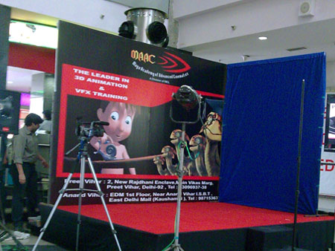
MALL EVENT

Slide 28
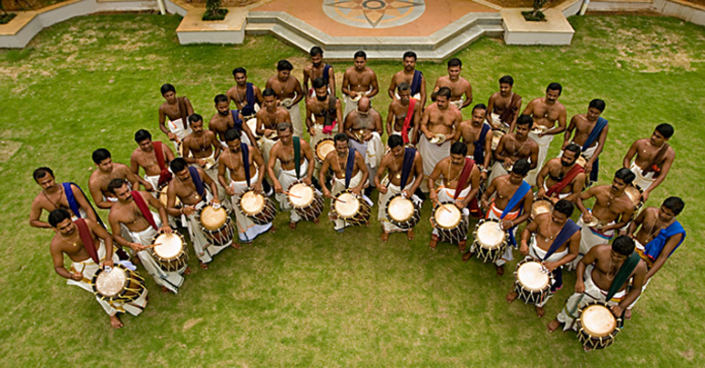
BRAND ACTIVTION EVENT

Slide 29
DIGITAL MEDIA
Sat light Channels
All over theaters (TN)
Local channels (TN)
FM Station(TN)

Slide 30
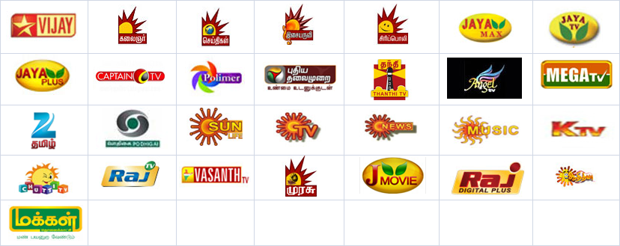
SATLIGHT CHANNELS

Slide 31





FM STATION/ RADIO

Slide 32
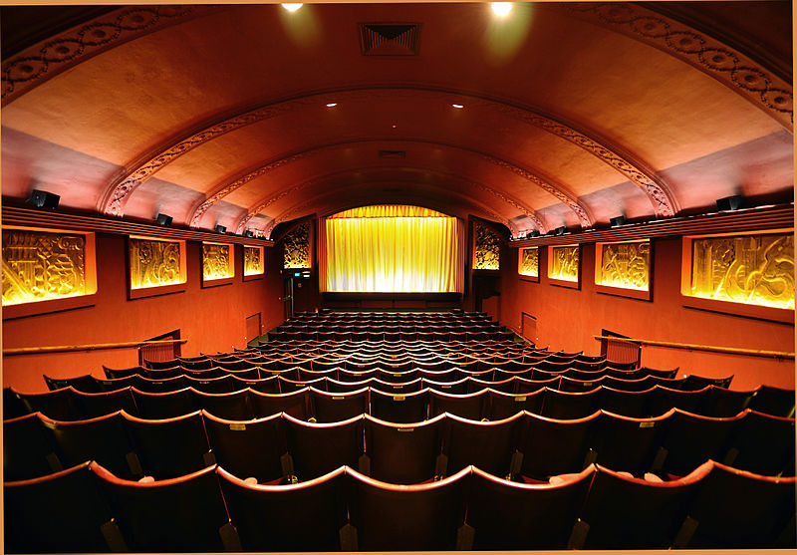
THEATER AD

Slide 33

MARKETING RESEARCH
Depends upon company & product
development

Slide 34
THANK YOU….
Ellipse Endorse Entertain

